Slide 1

Concepts in Enterprise Resource Planning
Fourth Edition
Chapter Five
Accounting in ERP Systems

Slide 2
Objectives
After completing this chapter, you will be able to:
Describe the differences between financial and managerial accounting
Identify and describe problems associated with accounting and financial reporting in unintegrated information systems
Describe how ERP systems can help solve accounting and financial reporting problems in an unintegrated system
Concepts in Enterprise Resource Planning, Fourth Edition
Concepts in Enterprise Resource Planning, Fourth Edition

Slide 3
Objectives (cont’d.)
Describe how the Enron scandal and the Sarbanes-Oxley Act have affected accounting information systems
Explain accounting and management-reporting benefits that accrue from having an ERP system
Explain the importance of Extensible Business Reporting Language (XBRL) in financial reporting
Concepts in Enterprise Resource Planning, Fourth Edition
Concepts in Enterprise Resource Planning, Fourth Edition

Slide 4
Introduction
In this chapter, you will learn about the activities in the Accounting functional area
Accounting is tightly integrated with all other functional areas
Accounting activities are necessary for decision making
Concepts in Enterprise Resource Planning, Fourth Edition

Slide 5
Accounting Activities
Areas of accounting:
  Financial accounting
  Managerial accounting
Financial accounting
  Documenting all transactions of a company that have an impact on the financial state of the firm
  Using documented transactions to create reports for external parties and agencies
  Reports, or financial statements, must follow prescribed rules and guidelines of various agencies
Concepts in Enterprise Resource Planning, Fourth Edition

Slide 6
Accounting Activities (cont’d.)
Common financial statements: balance sheets and income statements
Balance sheet
  Statement that shows account balances such as:
    Cash held
    Amounts owed to company by customers
    Cost of raw materials and finished-goods inventory
    Long-term assets such as buildings
    Amounts owed to vendors, banks, and other creditors
    Amounts owners have invested in company
Concepts in Enterprise Resource Planning, Fourth Edition

Slide 7
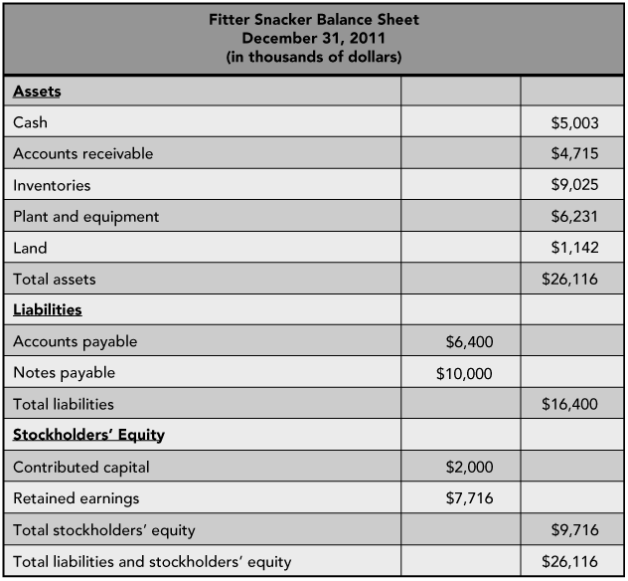
Figure 5-1 Fitter Snacker sample balance sheet
Concepts in Enterprise Resource Planning, Fourth Edition

Slide 8
Accounting Activities (cont’d.)
Income statement
  Profit and loss (P&L) statement
  Shows company’s sales, cost of sales, and profit or loss for a period of time (typically a quarter or year)
Integrated information system simplifies the process of closing the books and preparing financial statements
Managerial accounting: determining costs and profitability of company’s activities
Concepts in Enterprise Resource Planning, Fourth Edition

Slide 9
Figure 5-2 Fitter Snacker sample income statement
Concepts in Enterprise Resource Planning, Fourth Edition

Slide 10
Accounting Activities (cont’d.)
Quarterly financial statement
  Close books
  Closing entries to nominal accounts
  Nominal accounts – zero balance to start next cycle
  Ensure accounts accurate and up-to-date
  “Adjusting” entries
Integrated information system advantage
  Simplifies process of closing books and preparing financial statements
Concepts in Enterprise Resource Planning, Fourth Edition

Slide 11
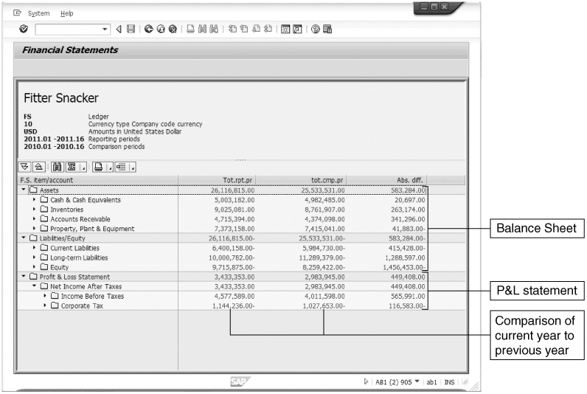
Figure 5-3 Balance sheet and income statement for Fitter Snacker in SAP ERP system
Concepts in Enterprise Resource Planning, Fourth Edition

Slide 12
Accounting Activities (cont’d.)
Managerial accounting
  Determine costs and profitability of company’s activities
  Provide managers with detailed information
    Informed decisions
    Create budgets
    Determine profitability
  Information that managers use to control day-to-day activities, develop long-term plans
Concepts in Enterprise Resource Planning, Fourth Edition

Slide 13
Using ERP for Accounting Information
Problems associated with unintegrated systems
  Data sharing usually did not occur in real time
    Accounting’s data were often out of date
  Accounting personnel had to do significant research
ERP system, with its centralized database, avoids these problems
In traditional accounting, company’s accounts are kept in a record called a general ledger
Concepts in Enterprise Resource Planning, Fourth Edition

Slide 14
Using ERP for Accounting Information (cont’d.)
In the SAP ERP system, input to general ledger occurs simultaneously with business transactions
Many SAP ERP modules cause transaction data to be entered into general ledger, including:
  Sales and Distribution (SD)
  Materials Management (MM)
  Financial Accounting (FI)
  Controlling (CO)
  Human Resources (HR)
  Asset Management (AM)
Concepts in Enterprise Resource Planning, Fourth Edition

Slide 15
Operational Decision-Making Problem: Credit Management
Unintegrated information system
  Out-of-date or inaccurate accounting data can cause problems when a company is making operational decisions
Industrial credit management
Fitter Snacker’s credit management procedures
Credit management in SAP ERP
Concepts in Enterprise Resource Planning, Fourth Edition

Slide 16
Industrial Credit Management
Credit management requires a good balance between:
  Granting sufficient credit to support sales and
  Making sure that the company does not lose too much money
Setting a limit on how much money a customer can owe at any one time
  Monitoring that limit as orders come in and payments are received
Concepts in Enterprise Resource Planning, Fourth Edition

Slide 17
Industrial Credit Management (cont’d.)
Sales representative needs to be able to review an up-to-date accounts receivable balance when an order comes in
Problems arise if Marketing and Accounting have unintegrated information systems
  Less than full cooperation on updates
Problems should not arise with an integrated information system
  Accounts receivable is immediately updated
Concepts in Enterprise Resource Planning, Fourth Edition

Slide 18
Fitter Snacker’s Credit Management Procedures
FS sales clerk refers to a weekly printout of a customer’s current balance and credit limit to see if credit should be granted
Sales data are transferred to Accounting by disk three times a week
Accounting clerk can use sales input to prepare a customer invoice
Accounting must make any adjustments for partial shipments before preparing the invoice
Accounting clerks process customer payments
Concepts in Enterprise Resource Planning, Fourth Edition

Slide 19
Credit Management in SAP ERP
SAP ERP would allow FS to set a credit limit for each customer
Company can configure any number of credit-check options in SAP ERP system
Advantages of using SAP ERP to manage credit
  Process is automated
  Data are available in real time
Concepts in Enterprise Resource Planning, Fourth Edition

Slide 20
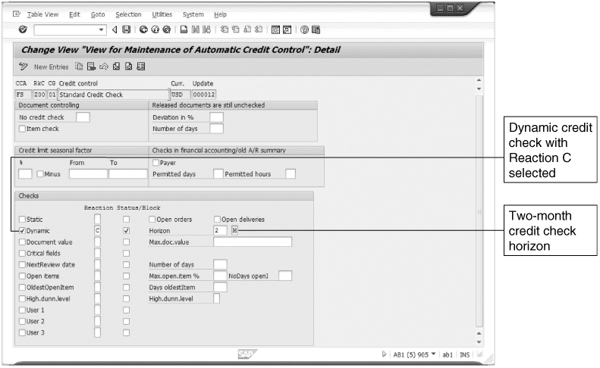
Figure 5-5 Credit management configuration
Concepts in Enterprise Resource Planning, Fourth Edition

Slide 21
Product Profitability Analysis
Business managers use accounting data to perform profitability analyses of a company and its products
When data are inaccurate or incomplete, the analyses are flawed
Main reasons for inaccurate or incomplete data
  Inconsistent recordkeeping
  Inaccurate inventory costing systems
  Problems consolidating data from subsidiaries
Concepts in Enterprise Resource Planning, Fourth Edition

Slide 22
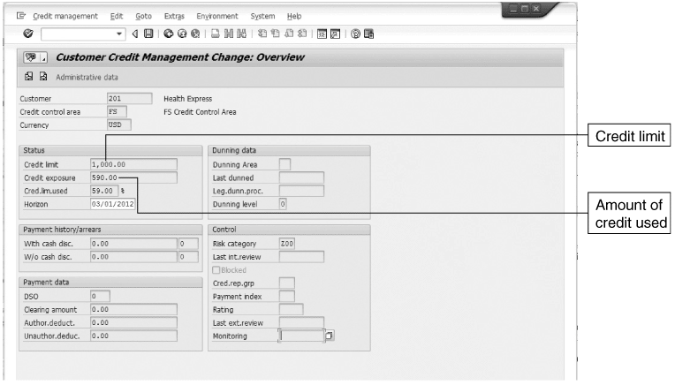
Figure 5-6 Credit management for Health Express
Concepts in Enterprise Resource Planning, Fourth Edition

Slide 23
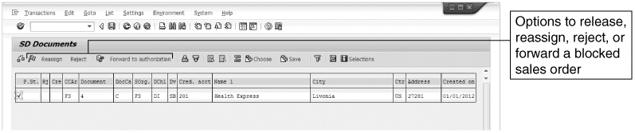
Figure 5-7 Blocked sales order
Concepts in Enterprise Resource Planning, Fourth Edition

Slide 24
Inconsistent Recordkeeping
Each of FS’s marketing divisions maintains its own records and keeps track of sales data differently
Paper records might be inaccurate or missing, making validity of the final report questionable
Without integrated information systems, accounting and reporting to management requires:
  Working around limitations of information systems to produce useful output
ERP system minimizes or eliminates these problems
Concepts in Enterprise Resource Planning, Fourth Edition

Slide 25
Inaccurate Inventory Costing Systems
Correctly calculating inventory costs
  One of the most important and challenging accounting tasks in any manufacturing company
Inventory cost accounting background
  Manufactured item’s cost has three elements:
    Cost of raw materials
    Cost of labor employed directly in production of item
    Overhead: all other costs
Concepts in Enterprise Resource Planning, Fourth Edition

Slide 26
Inaccurate Inventory Costing Systems (cont’d.)
Inventory cost accounting background (cont’d.)
  Direct costs: materials and labor
    Can be estimated fairly accurately
  Indirect costs: overhead items
    Difficult to associate with specific product(s)
  Standard costs for a product are established by:
    Studying historical direct and indirect cost patterns
    Taking into account the effects of current manufacturing changes
  Cost variances: differences between actual costs and standard costs
Concepts in Enterprise Resource Planning, Fourth Edition

Slide 27
Inaccurate Inventory Costing Systems (cont’d.)
ERP and inventory cost accounting
  Many companies with unintegrated accounting systems analyze their cost variances infrequently
    Often, they do not know how much it actually costs to produce a unit of a product
  If FS had an ERP system, employees throughout the company would have recorded costs in a company-wide database as they occurred
  ERP system configurations allow analysts to track costs using many bases
Concepts in Enterprise Resource Planning, Fourth Edition

Slide 28
Inaccurate Inventory Costing Systems (cont’d.)
Product costing example
  Suppose Fitter Snacker wishes to update standard costs for NRG-A bars
  Product cost analysis for NRG-A bar
Product cost analysis in SAP ERP
  Product cost variant: method for developing a product cost in an ERP system
Concepts in Enterprise Resource Planning, Fourth Edition

Slide 29
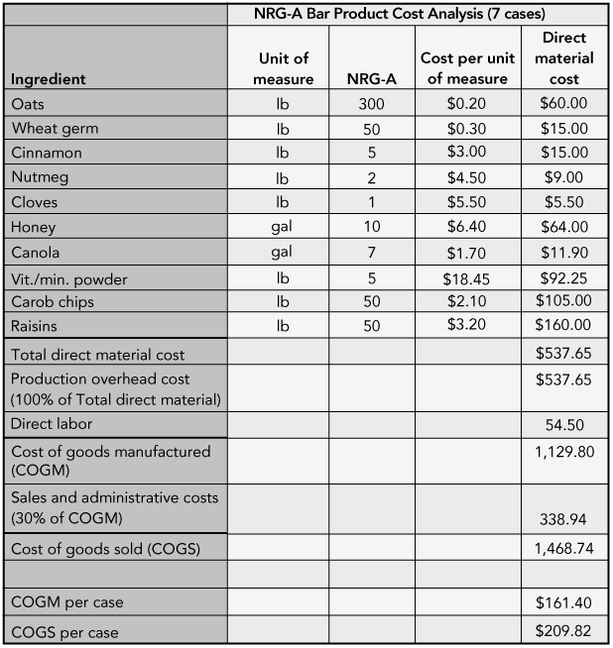
Figure 5-8 Product cost analysis for NRG-A bar
Concepts in Enterprise Resource Planning, Fourth Edition

Slide 30
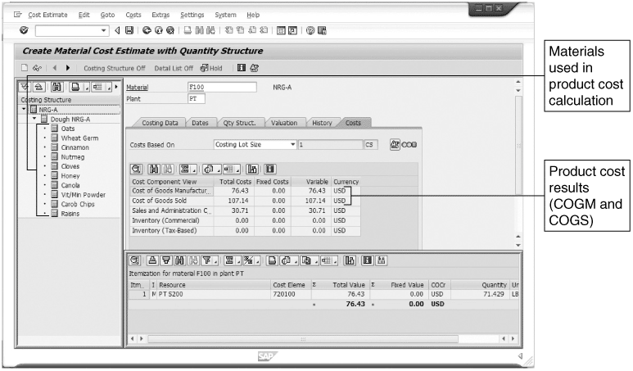
Figure 5-9 Product cost analysis result in SAP ERP
Concepts in Enterprise Resource Planning, Fourth Edition

Slide 31
Inaccurate Inventory Costing Systems (cont’d.)
Activity-based costing and ERP
  Activity-based costing (ABC)
    Accountants identify activities associated with overhead cost generation and then keep records on costs and on activities
  ABC requires more bookkeeping than traditional costing methods
Concepts in Enterprise Resource Planning, Fourth Edition

Slide 32
Companies with Subsidiaries
Account balances for each entity must be compiled and forwarded to the home office
Consolidated statement for the company as a whole must be created
Currency translation
  Problems when currency translation is needed for a subsidiary’s accounts
Intercompany transactions
  Transactions that occur between companies and their subsidiaries
Concepts in Enterprise Resource Planning, Fourth Edition

Slide 33
Management Reporting with ERP Systems
Generating the right reports for the right situation is often challenging
Without an ERP system, the job of tracking all the numbers that need to go into a report is a monumental undertaking
With ERP system, vast amount of information is available for reporting purposes
Concepts in Enterprise Resource Planning, Fourth Edition

Slide 34
Document Flow for Customer Service
With an ERP system, all transactions in all areas of a company get posted in a centralized database
Each transaction posted in SAP ERP gets its own unique document number
  Allows quick access to the data
In SAP ERP, document numbers for related transactions are associated in the database
  Provides an electronic audit trail
Concepts in Enterprise Resource Planning, Fourth Edition

Slide 35
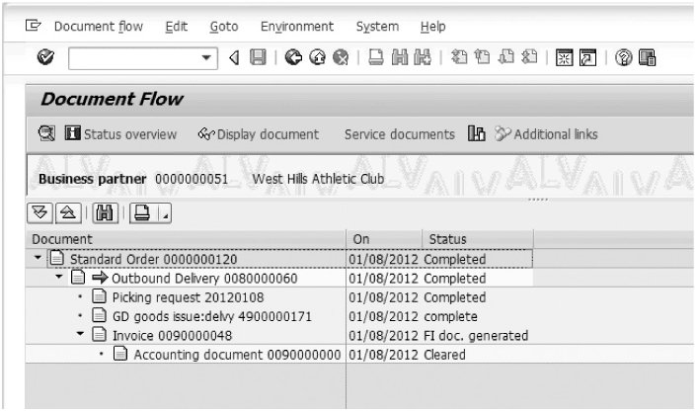
Document Flow for Customer Service (cont’d.)
Figure 5-10 Document flow of a transaction in SAP ERP
Concepts in Enterprise Resource Planning, Fourth Edition

Slide 36
Built-In Management-Reporting and Analysis Tools
Accounting records maintained in the common database
Advantage of using a database is the ability to query the records to:
  Produce standard reports
  Answer ad hoc questions
SAP provides a data warehouse within each major module
  Data warehouse: repository for data from various sources
Concepts in Enterprise Resource Planning, Fourth Edition

Slide 37
The Enron Collapse
October 16, 2001: Enron was one of the world’s largest electricity and natural gas traders
  Reported a $618 million third-quarter loss and disclosed a $1.2 billion reduction in shareholder equity
U.S. Securities and Exchange Commission (SEC) inquiry into possible conflict of interest related to company’s dealings with partnerships run by CFO Fastow
Concepts in Enterprise Resource Planning, Fourth Edition

Slide 38
The Enron Collapse (cont’d.)
Volume of financial contracts was far greater than volume of contracts to actually deliver commodities
Some partnerships were faked to mask billions of dollars in debt
Enron’s financial statements had been audited by Arthur Andersen, a highly regarded accounting firm
Andersen employees on the Enron engagement team were instructed to destroy documentation relating to Enron
Concepts in Enterprise Resource Planning, Fourth Edition

Slide 39
Outcome of the Enron Scandal
Shareholders lost an estimated $40 billion dollars
Thousands of workers lost their jobs
31 individuals were either charged or pled guilty to criminal charges
Jurors convicted accounting firm Arthur Andersen for obstructing justice by destroying Enron documents
U.S. Congress passed Sarbanes-Oxley Act of 2002
  Act was designed to prevent the kind of fraud and abuse that led to the Enron downfall
Concepts in Enterprise Resource Planning, Fourth Edition

Slide 40
Key Features of the Sarbanes-Oxley Act
Designed to encourage top management accountability in firms that are publicly traded in the United States
Title IX
  Financial statements filed with the Securities and Exchange Commission must include a statement signed by the chief executive officer and chief financial officer, certifying that the financial statement complies with SEC rules
Concepts in Enterprise Resource Planning, Fourth Edition

Slide 41
Key Features of the Sarbanes-Oxley Act (cont’d.)
Title II
  Auditor independence
    Limits non-audit services that an auditor can provide
Title IV
  More stringent requirements for financial reporting
Concepts in Enterprise Resource Planning, Fourth Edition

Slide 42
Implications of the Sarbanes-Oxley Act for ERP Systems
To meet the internal control report requirement, a company must:
  Document the controls that are in place
  Verify that the controls are not subject to error or manipulation
Companies with ERP systems in place will have an easier time complying with the Sarbanes-Oxley Act than will companies without ERP
Concepts in Enterprise Resource Planning, Fourth Edition

Slide 43
Archiving
SAP ERP software offers very few ways to delete items
Data are removed from SAP ERP system only after they have been recorded to media (tape backup, DVD-R) for permanent storage
Archive: permanent storage
SAP ERP systems keep track of when data are created or changed
  Change Record
Concepts in Enterprise Resource Planning, Fourth Edition

Slide 44
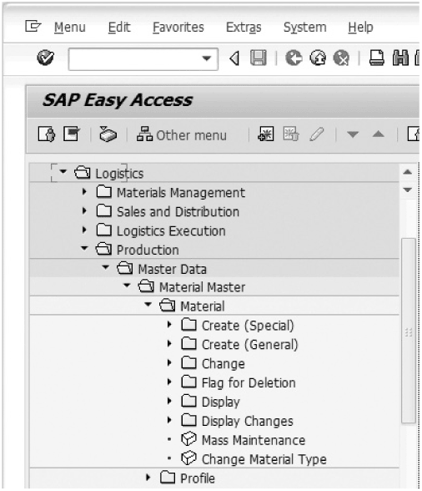
Figure 5-11 Transaction options for material master data
Concepts in Enterprise Resource Planning, Fourth Edition

Slide 45
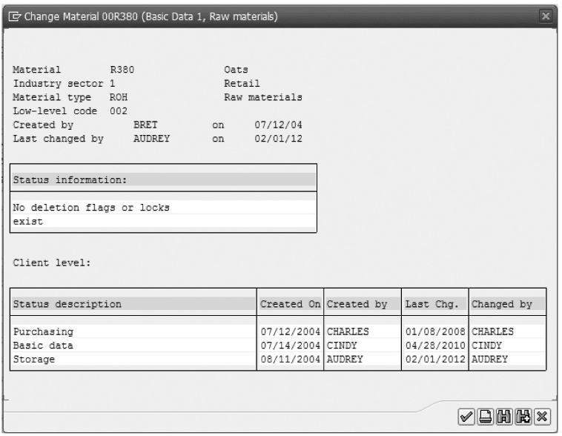
Archiving (cont’d.)
Figure 5-12 Change Record for material master
Concepts in Enterprise Resource Planning, Fourth Edition

Slide 46
User Authorizations
SAP ERP has sophisticated user administration tools that allow different levels of authorization management
  Ensure that employees can perform only the transactions required for their jobs
Profile Generator
  Provides a simple method for selecting functions that a user should be allowed to perform
Concepts in Enterprise Resource Planning, Fourth Edition

Slide 47
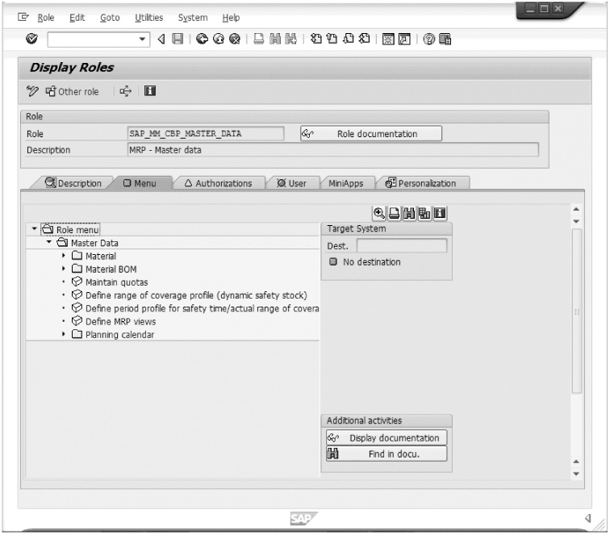
Figure 5-13 Display Roles screen in SAP
Concepts in Enterprise Resource Planning, Fourth Edition

Slide 48
Tolerance Groups
Setting limits on the size of transaction an employee can process
  In an SAP ERP system, this is done using tolerance groups
Tolerance groups
  Preset limits on an employee’s ability to post transactions
  Set limits on the dollar value for a single item in a document as well as the total value of document
Concepts in Enterprise Resource Planning, Fourth Edition

Slide 49
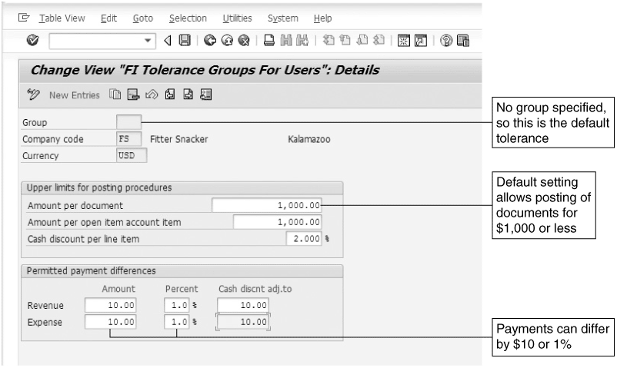
Figure 5-14 Default tolerance group
Concepts in Enterprise Resource Planning, Fourth Edition

Slide 50
Financial Transparency
ERP systems provide the ability to drill down from a report to the source documents (transactions) that created it
  Makes it easier for auditors to confirm the integrity of reports
With a properly configured and managed ERP system, there are direct links between the company’s financial statements and individual transactions that make up the statements
  Fraud and abuse can be detected more easily
Concepts in Enterprise Resource Planning, Fourth Edition

Slide 51
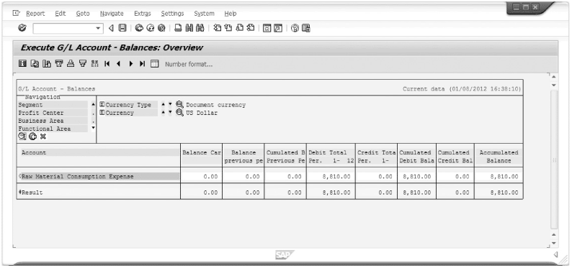
Figure 5-15 G/L (general ledger) account balance for raw material consumption
Concepts in Enterprise Resource Planning, Fourth Edition

Slide 52
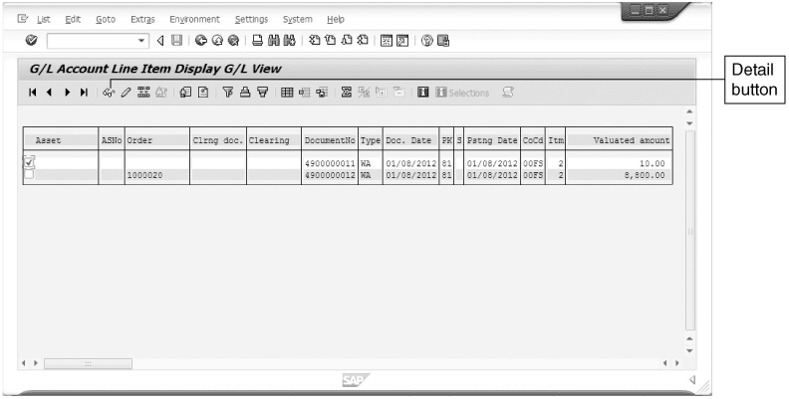
Financial Transparency (cont’d.)
Figure 5-16 Documents that make up G/L account balance for raw material consumption
Concepts in Enterprise Resource Planning, Fourth Edition

Slide 53
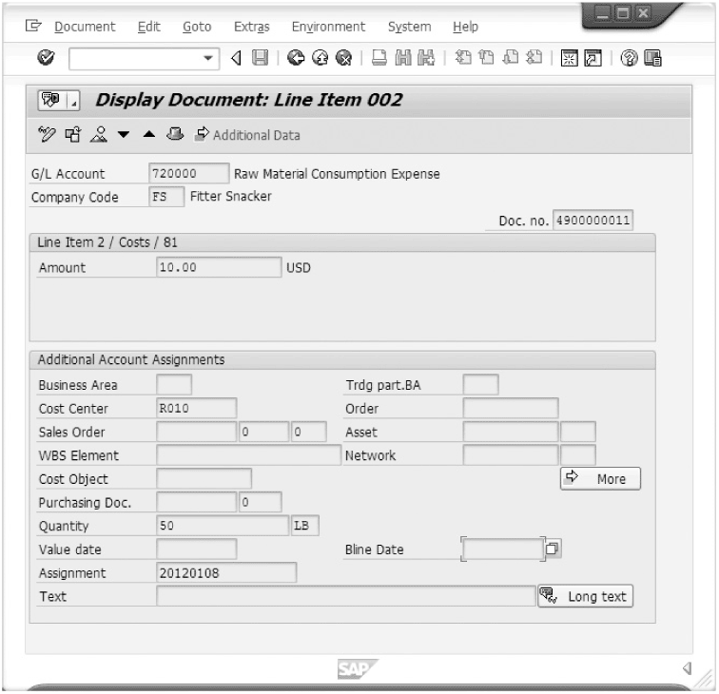
Financial Transparency (cont’d.)
Figure 5-17 Details on $10.00 line item in G/L account for raw material consumption
Concepts in Enterprise Resource Planning, Fourth Edition

Slide 54
Trends in Financial Reporting (XBRL)
Extensible Business Reporting Language (XBRL)
  Standards based language
  Extensible Markup Language (XML) coded data directly from web page into database
  Reports processed faster and validated easier
  ERP systems accept data in XML and XBRL
Concepts in Enterprise Resource Planning, Fourth Edition

Slide 55
Summary
Companies need accounting systems to record transactions and generate financial statements
Unintegrated information systems
  Accounting data might not be current
    Can cause problems for sales representatives trying to make operational decisions
  Data can be inaccurate
    Can affect decision making and therefore profitability
Concepts in Enterprise Resource Planning, Fourth Edition

Slide 56
Summary (cont’d.)
Closing the books at the end of an accounting period can be difficult with an unintegrated IS, but is relatively easy with an integrated IS
  Closing the books means zeroing out temporary accounts
Using an integrated IS and a common database to record accounting data has important inventory cost-accounting benefits
  Can lead to more accurate product cost calculations
  Can help managers determine which products are profitable and which are not
Concepts in Enterprise Resource Planning, Fourth Edition

Slide 57
Summary (cont’d.)
Use of an integrated system and a common database to record accounting data has important management-reporting benefits
  Built-in drill-down and query tools available
Sarbanes-Oxley Act, 2002 U.S. federal regulation
  Written and passed in the wake of Enron collapse
  Promoted management accountability by requiring extra financial approval and reporting
  ERP systems can help companies meet the requirements of this legislation
Concepts in Enterprise Resource Planning, Fourth Edition

Slide 58
Summary (cont’d.)
Trends in financial reporting
  XBRL
  XML
  ERP systems accept data in XML and XBRL into database
Concepts in Enterprise Resource Planning, Fourth Edition

